Slide 1
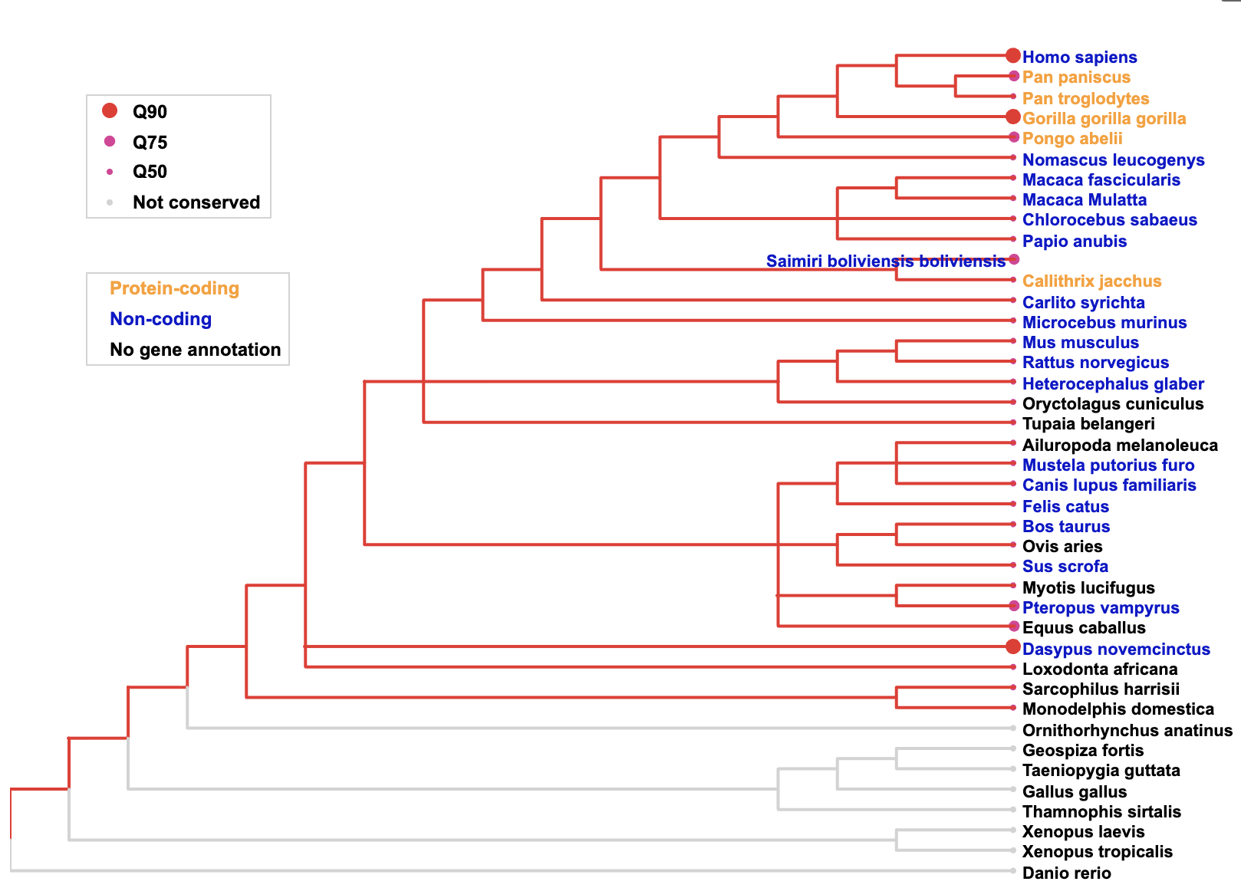

Slide 2
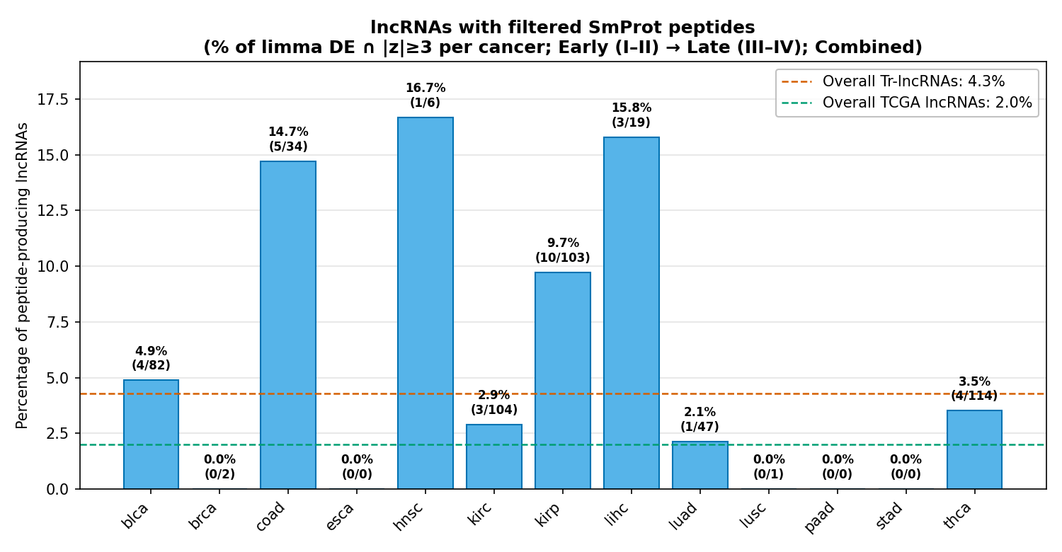
A
10,350 samples
In TCGA (33 cancer types)
14,855 lncRNA genes
In GenCode
Filtering:
Non-primary tumor
ID gene matching
9,182 cancerous samples
In TCGA (32 cancer types)
T- stage (a-d)
5,640 samples
across 13 cancer types (n>100)
M-state (e-f) 4,854 samples
across 15 cancer types (n>100)
lncRNA-MPs
647 genes
2,606 MPs
Micropeptides (MPs)
Tr-lncRNAs (a-f)
1,608 genes
Tr-lncRNA-MPs
124 genes
501 MPs
B

